Slide 1
IOT-1023-Assignment 10
By:
Alexandre Gauthier
Christian Lachapelle
Instructor:
Yousef Elarian
November 24th, 2020

Slide 2
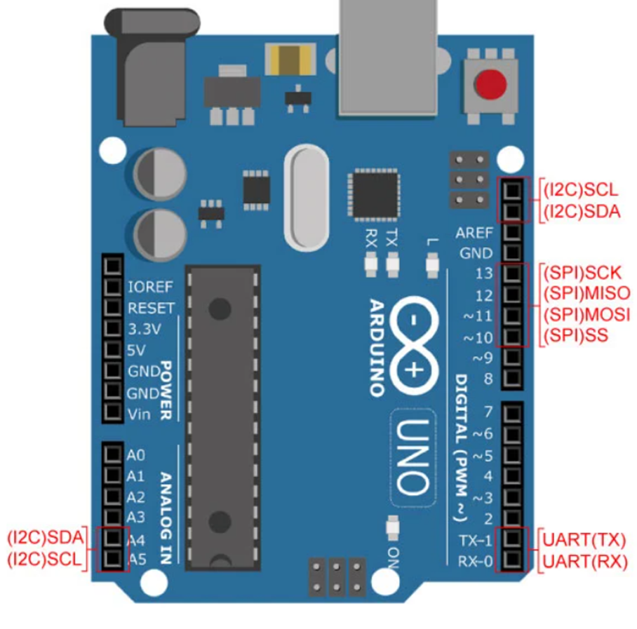
Part 1. Explain the basics!
Notes:
Img retrieved from week 10 Arduino15 PP

Slide 3
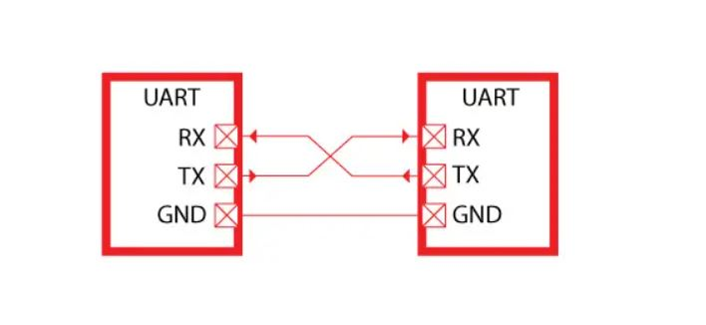
Universal Asynchronous Receive Transmit
(UART)
Simple
9600 bits/s**
Up to 2 devices
Full duplex
Uses digital pin 0 (RX) and Digital pin 1 (TX) or the USB port
Does not have multiple master or slave devices
Notes:
Img From UART Communication Basics, Working, Applications, Pros and Cons (microcontrollerslab.com)
Universal asynchronous receiver-transmitter - Wikipedia

Slide 4
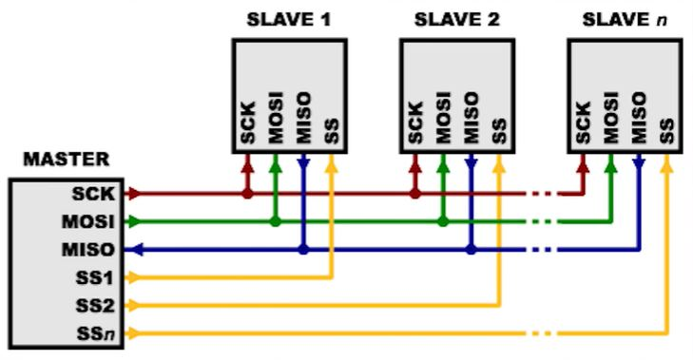
(I2C) Inter-Integrated-circuit
Easy to chain many devices
Speeds currently up to 5 Mbps **
7 bit address system translating to 127 potential slave devices
Half duplex
Can have multiple slaves and masters
Can use analog pins A4(SDA) and A5(SCL) or the digital pins labelled SDA SCL (2 wires)
Notes:
How I2C Communication Works & How To Use It with Arduino (howtomechatronics.com)
https://www.youtube.com/watch?v=mi24IxXEqzA
https://en.wikipedia.org/wiki/I%C2%B2C

Slide 5
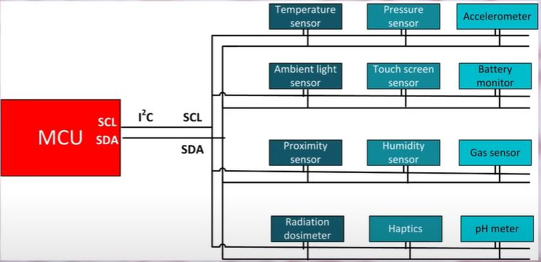
(SPI) Serial Peripheral Interface
Increases in complexity as number of devices increases
Fastest at 60 Mbps **
Number of devices limited by practical limits (will become complicated)
Number of wires 4 digital pins
        13 SCK (serial clock)
        12 Master in Slave out
        11 Master out Slave in
        10 SlaveSelect
Full Duplex
Only 1 master device, multiple slaves
Notes:
Serial Peripheral Interface – Wikipedia
Isolating SPI for High Bandwidth Sensors | Analog Devices speed reference In first paragraph
(4) SPI in a nutshell + Arduino & Raspberry Pi implementation: Electronics Crash Course 14 - YouTube

Slide 6
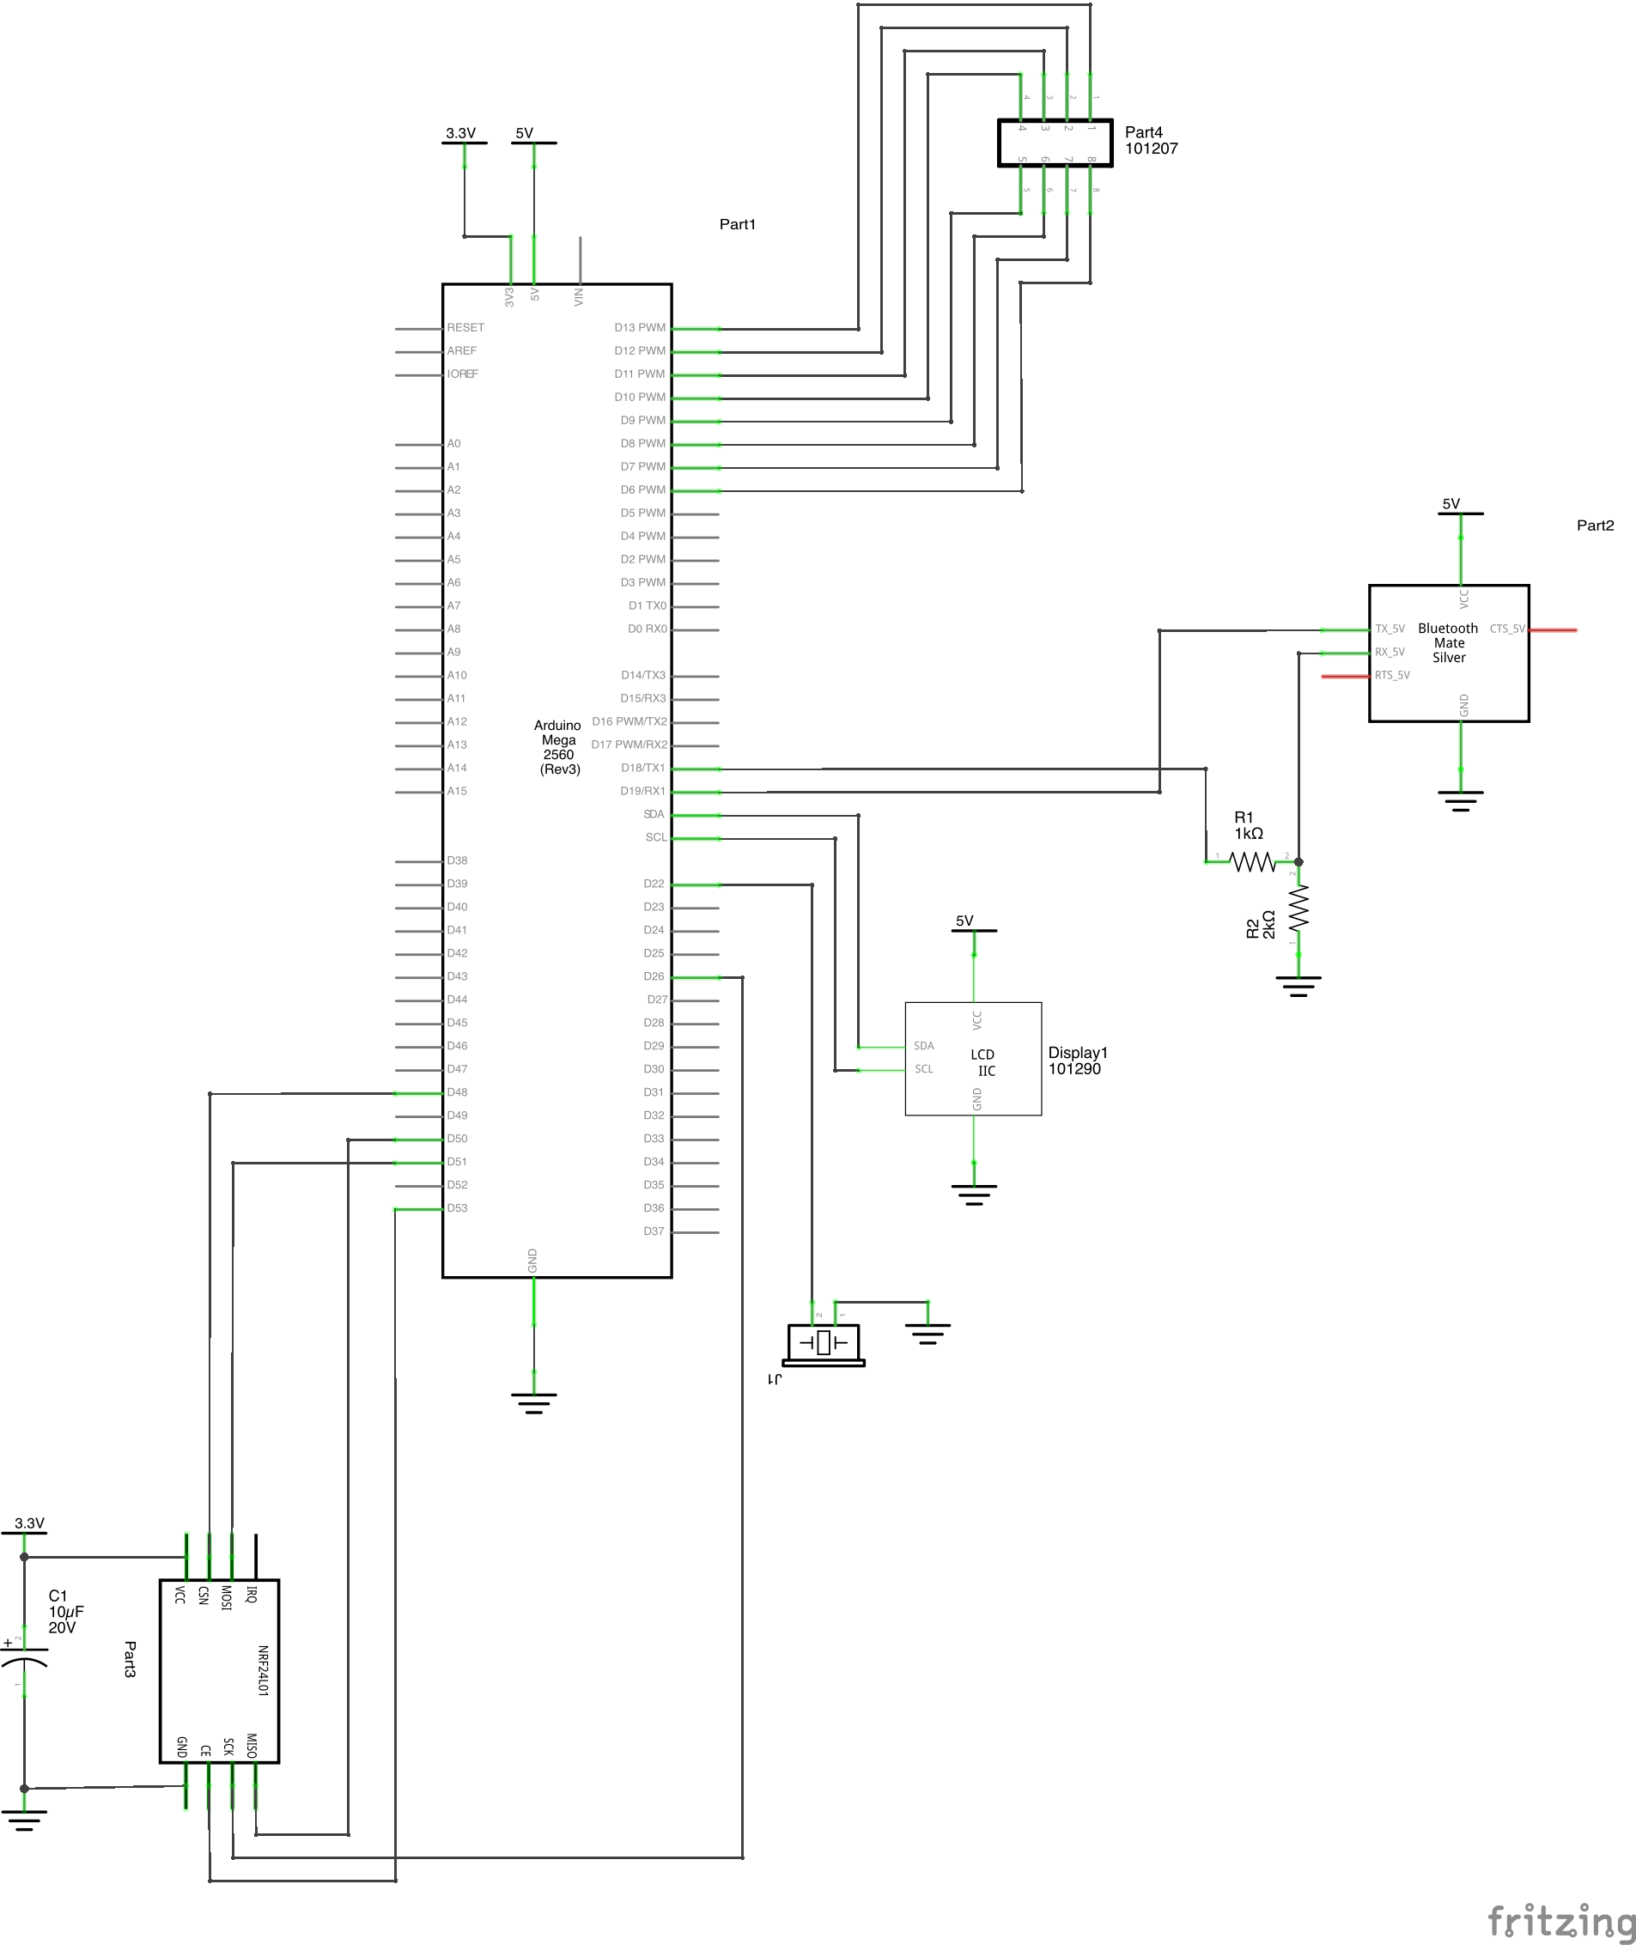
Part 2: Sketch’s and Hardware

Slide 7
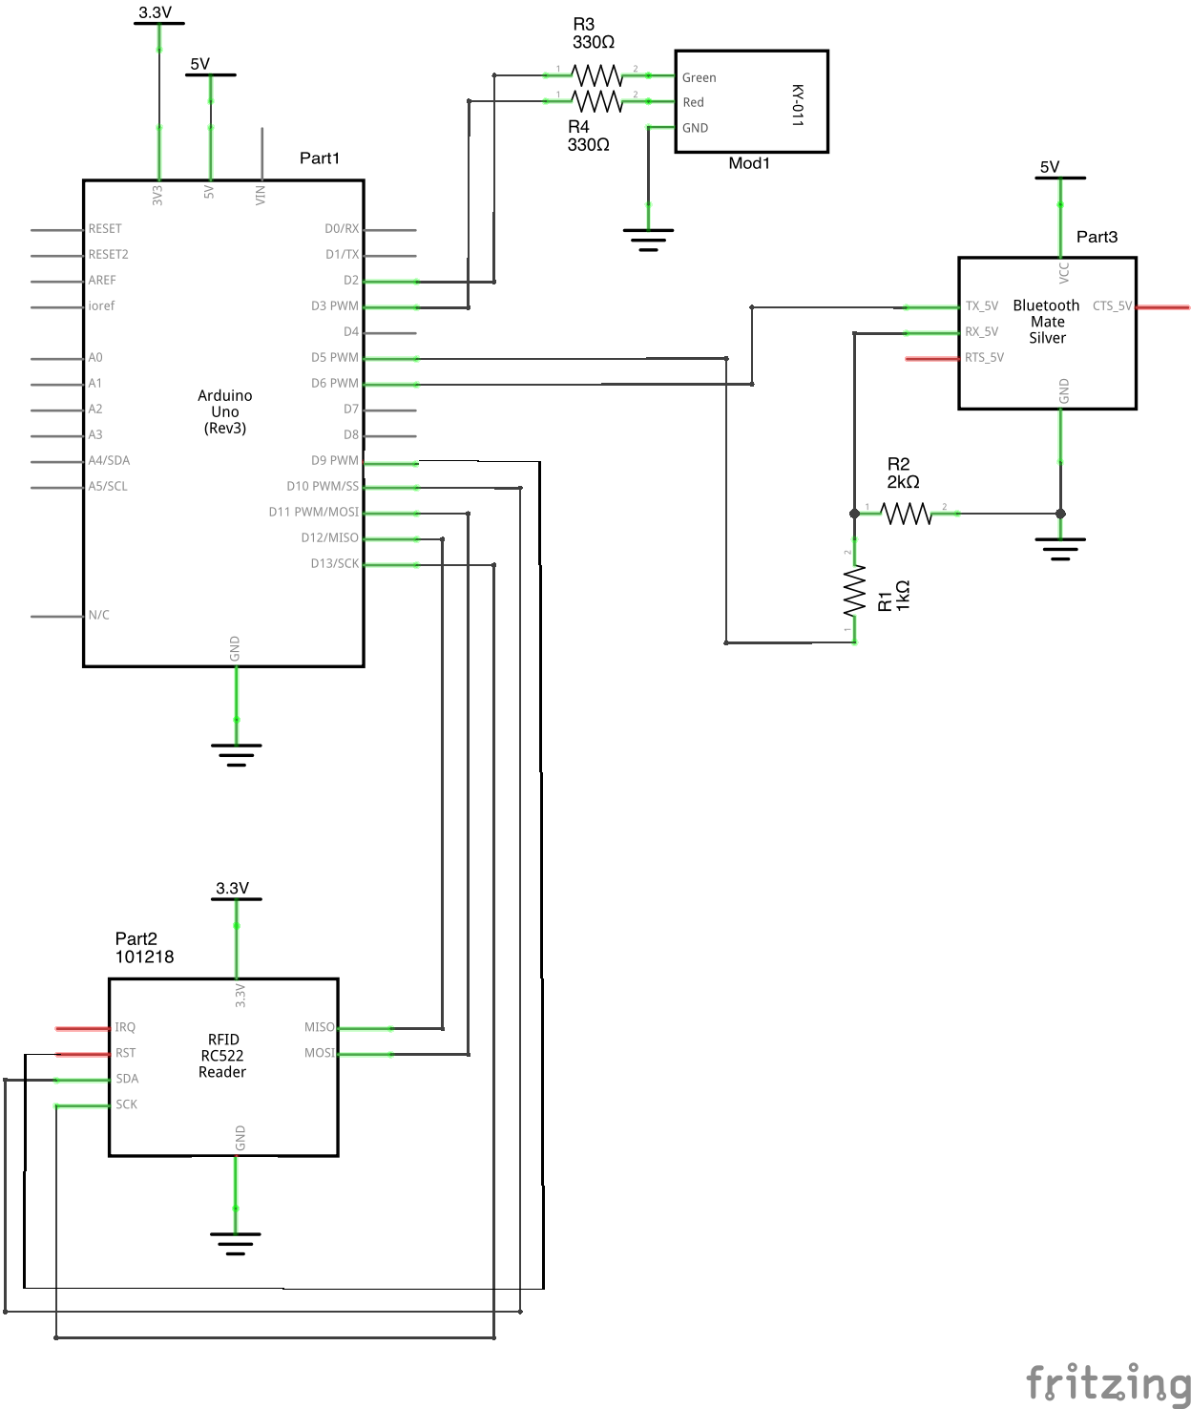
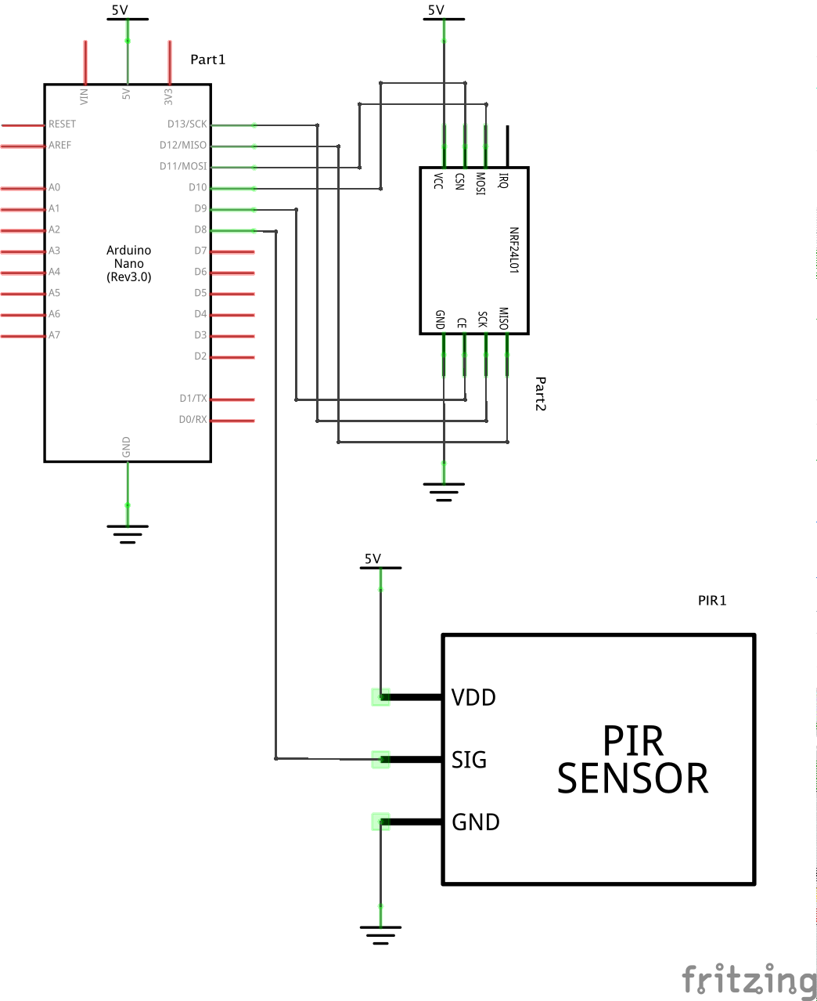

Slide 8
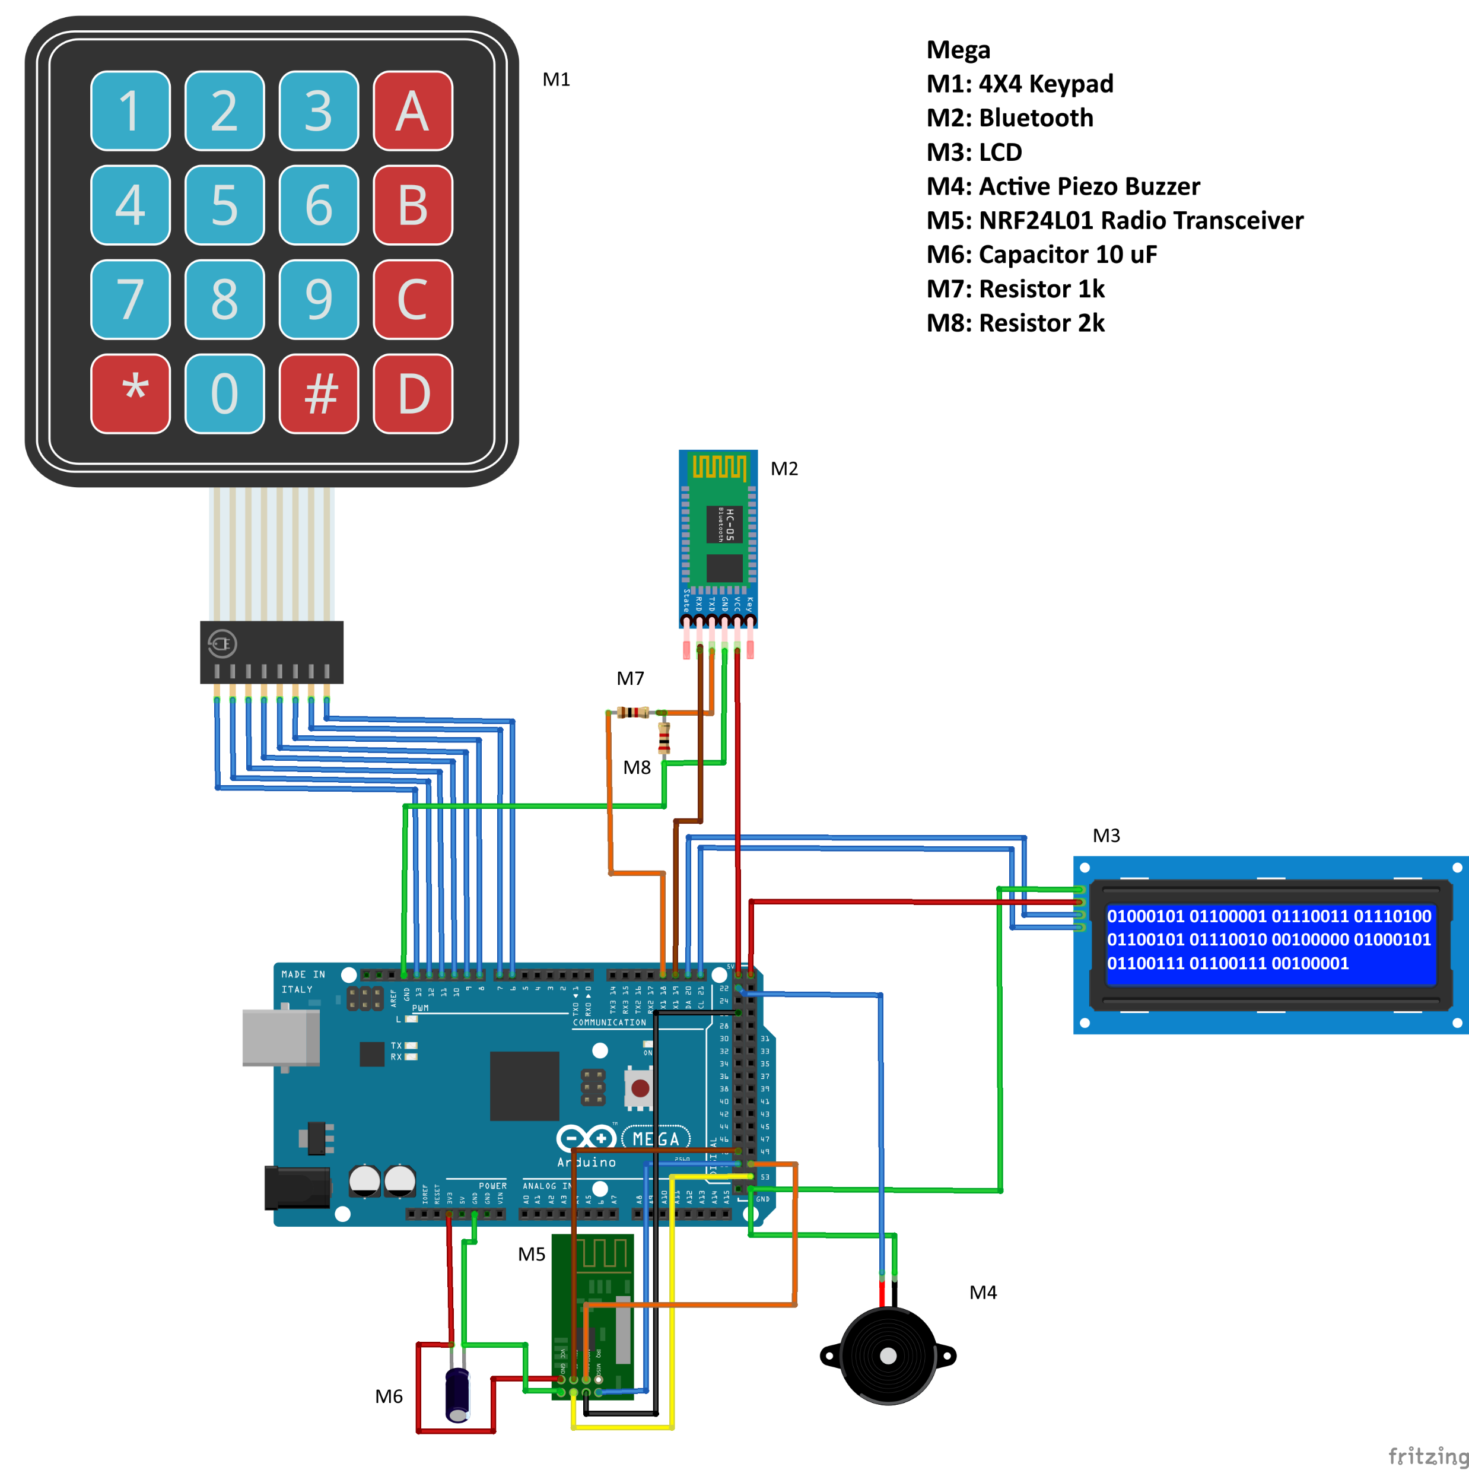

Slide 9
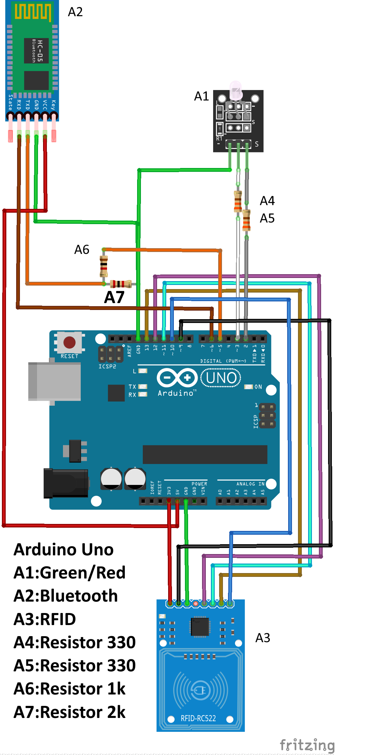
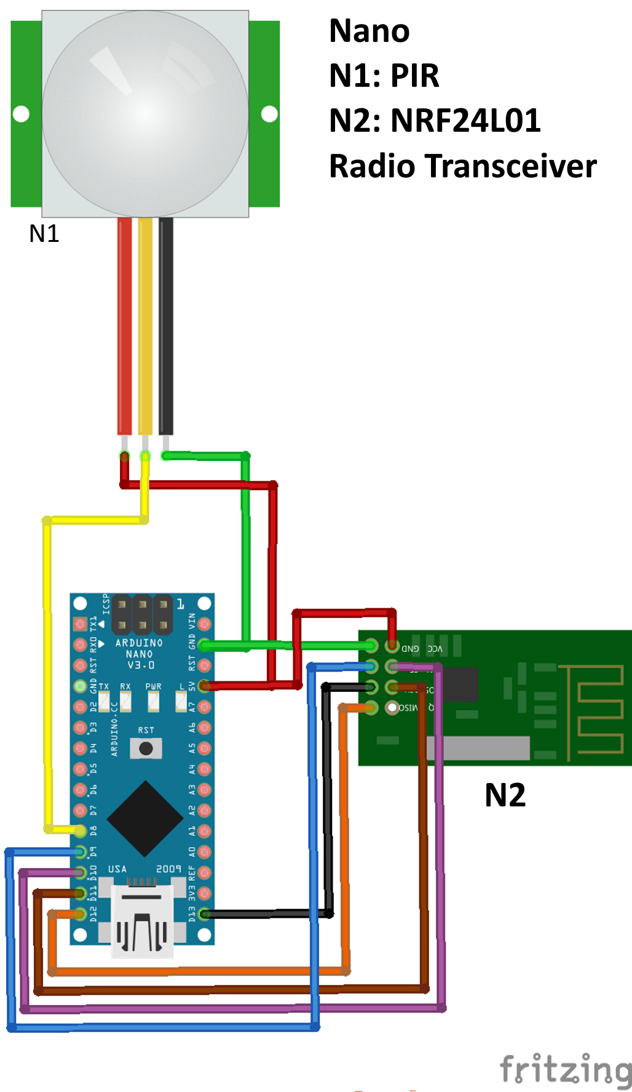

Slide 10
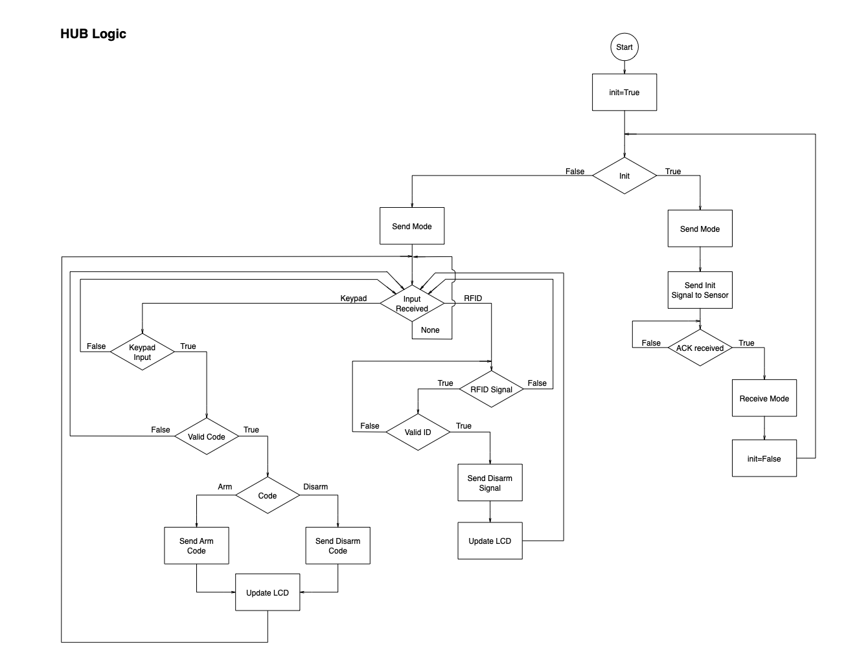
Part 3: Logic
Hub Logic

Slide 11
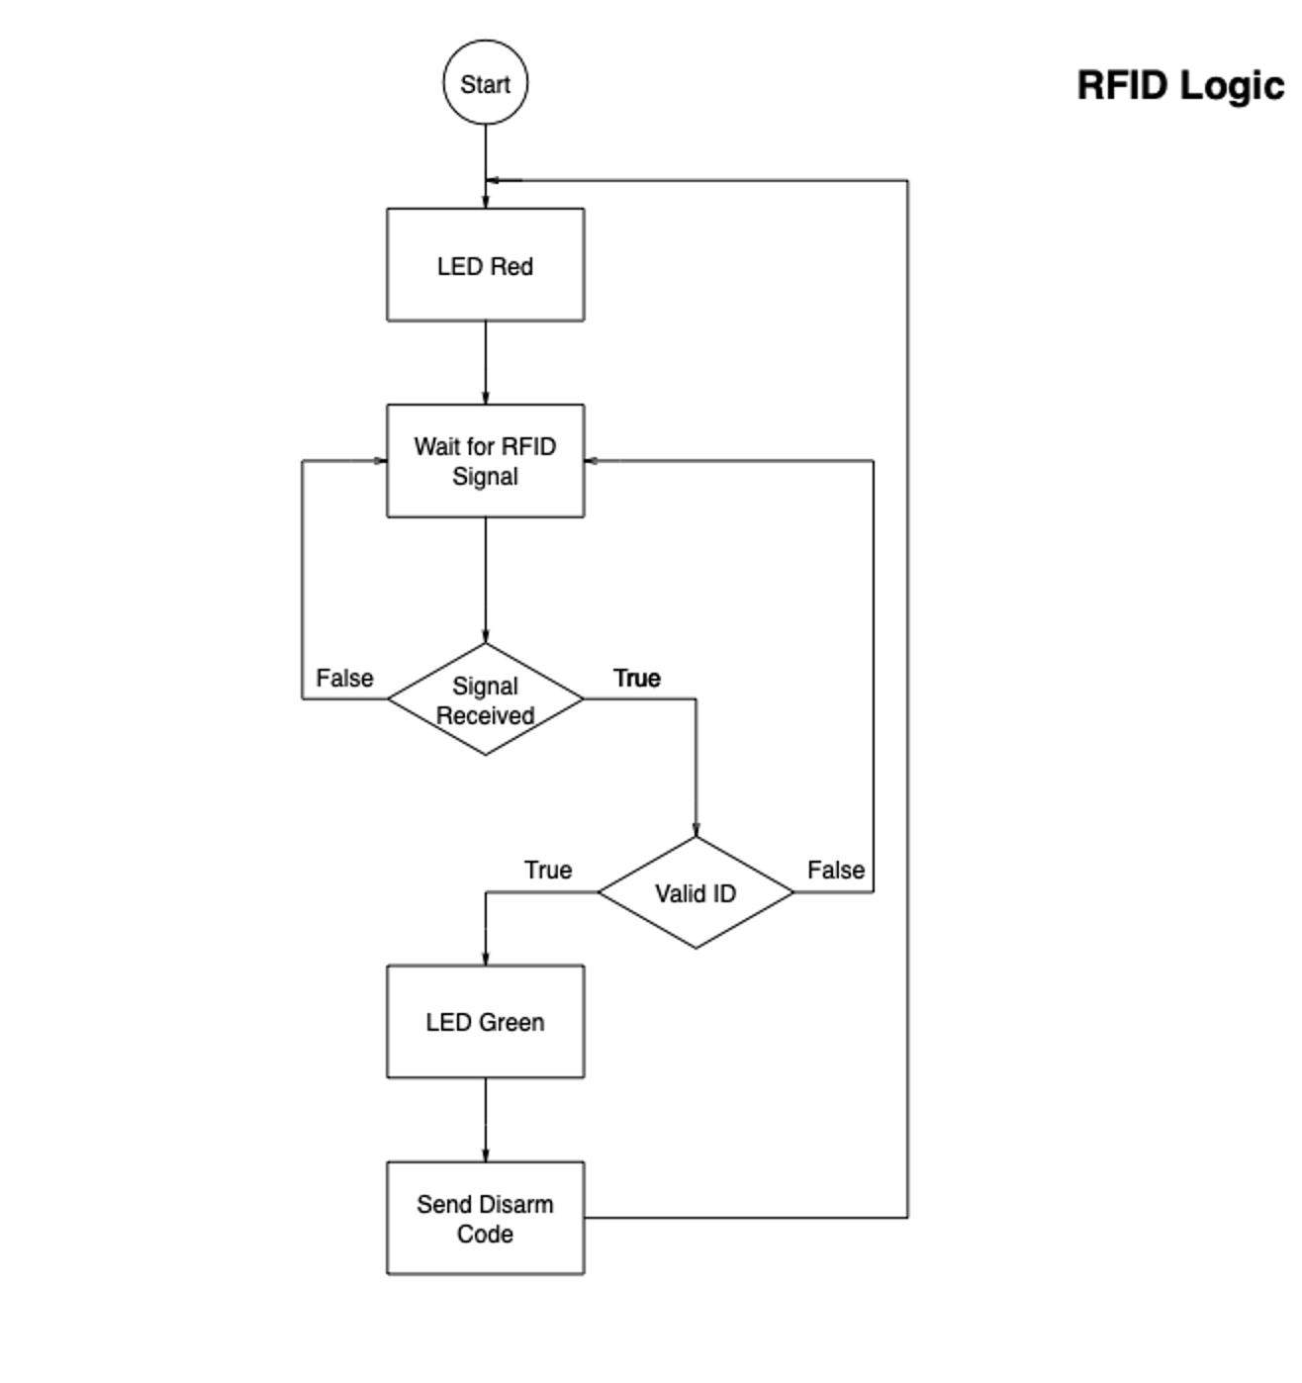
RFID Logic

Slide 12
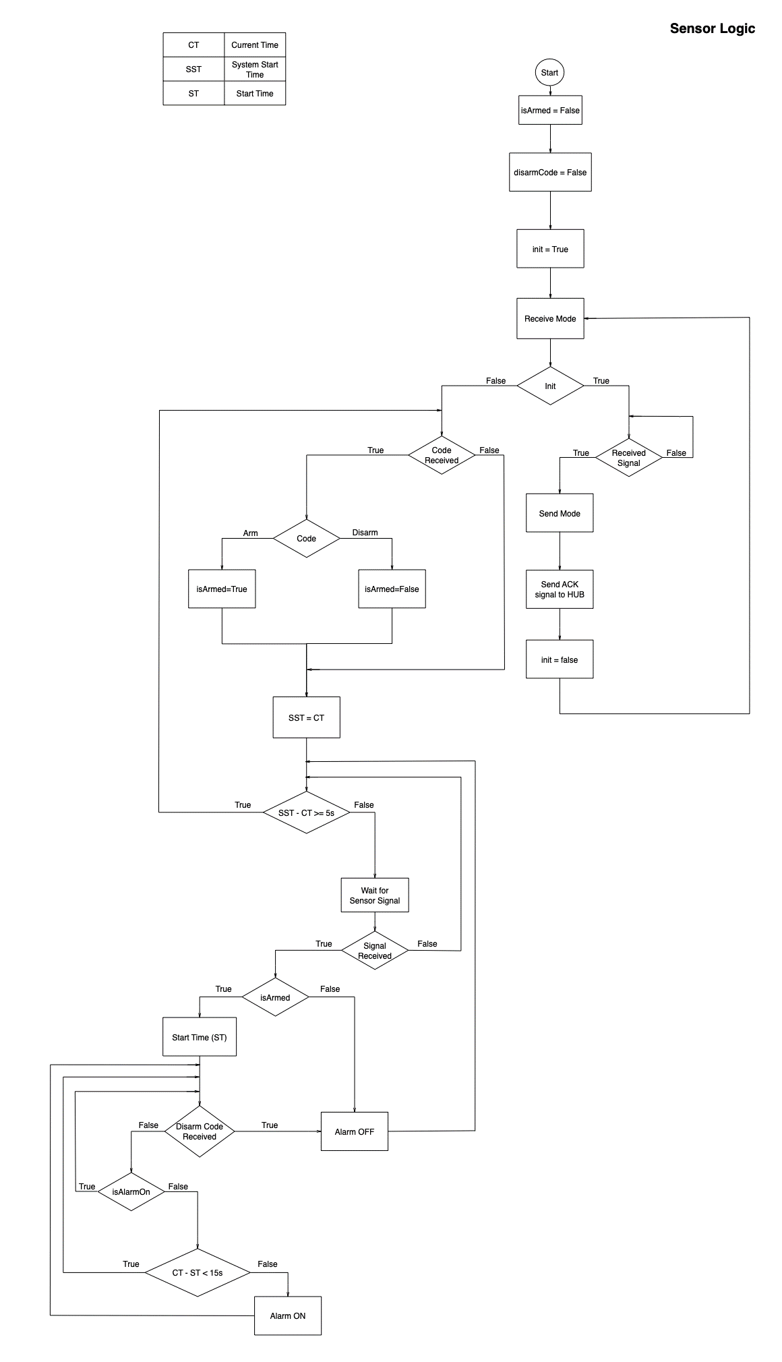
Sensor Logic

Slide 13
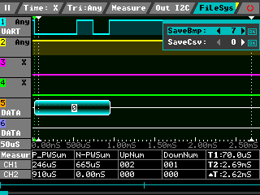
Logic
Analysis
UART

Slide 14
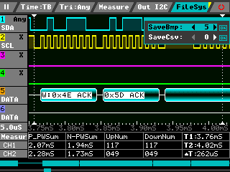
Logic
Analysis
I2C

Slide 15
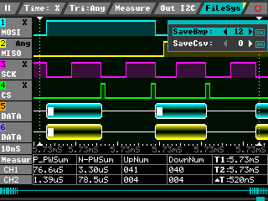
Logic Analysis
SPI
RF24L0

Slide 16
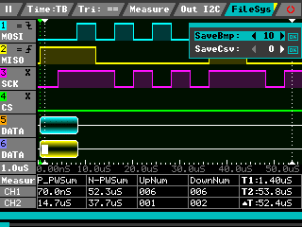
Logic Analysis
SPI
RFID

Slide 17
https://www.youtube.com/watch?v=wBovClOPBvw

